Slide 1
Ethical Hacking Internship
Task 3 presentation

Slide 2
Report on Task 3
Title: Cross Site Scripting Domain: vulnweb.com Subdomain: http://testasp.vulnweb.com/ By following the steps ahead you can also check vulnerability of this website :- 1st Vulnerability: XSS on the search bar 2nd Vulnerability: XSS on the register section of the website

Slide 3
1st Vulnerability
XSS ON SEARCH BAR: Steps to follow to get vulnerability : 1- Click on the search option on the navigation panel among other options. 2- Now type any message on the search bar 3- Check if it is sensitive to the EXACT same word you typed 4- Now type in the script - “<script>alert(1)</script>” in the search bar 5 - A message box should pop up after clicking enter saying “1”
A screenshot of this has been put up on the next slide

Slide 4
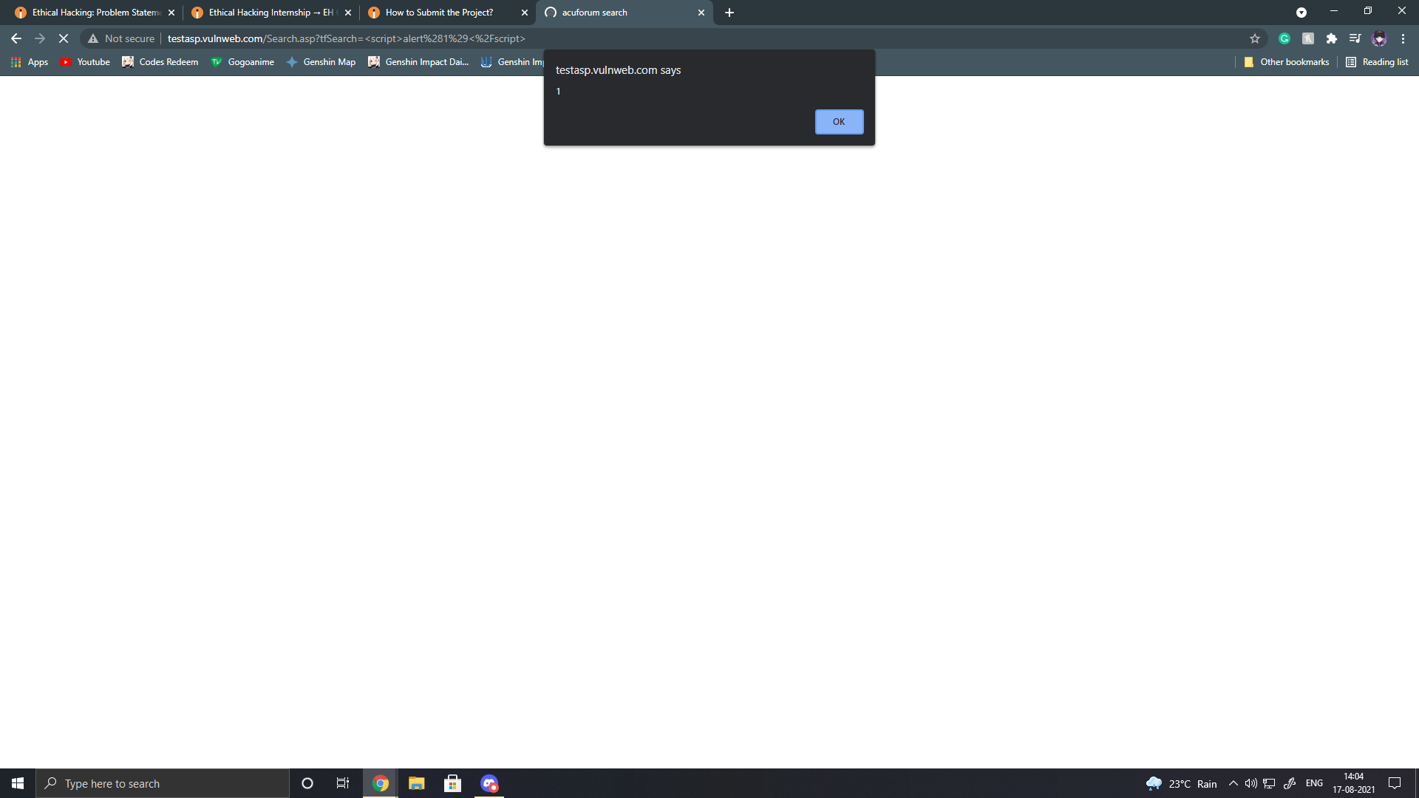

Slide 5
2nd Vulnerability
XSS ON THE REGISTER SECTION: Steps to follow to get vulnerability: 1- Click on the register option on the navigation panel 2- Add in fake details 3- Login using the fake details you entered 4- Once you press enter it will show you and error message box 5- When you also try to log out it will show and error message box Video of this XSS vulnerability in the next slide

Slide 6
Link to video below :-
Google Drive Link for video - https://drive.google.com/file/d/111x-hw359ww5dsxOnwws65wlfbq_hCmY/view?usp=sharing

Slide 7
Continuation to the report on Task 3 -
Adding on to this report this will impact your data to be stolen easily by Cross Site Scripting which can be harmful for you company. There are ways to prevent these types of attacks, you can always keep you software up to date. Moreover, you can have a Web Application Firewall to protect you website. Not only this but , you can also enable noscripts on your website.
More screenshots and video regarding this website’s vulnerability

Slide 8
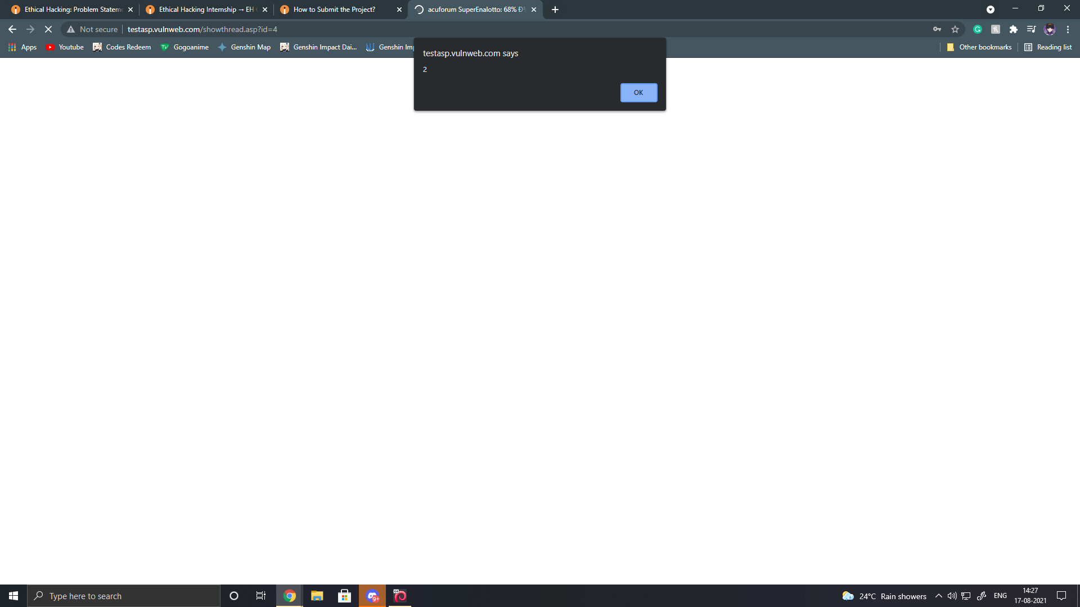
Google Drive link to Search bar XSS video - https://drive.google.com/file/d/1PMH8AKaXd37jrjcVZJgk8MdSldNQpoMC/view?usp=sharing

Slide 9
Thank you
Task 3 presentation complete

